Slide 1

Database Design: Semester Project
Presented By: Brandon Masluk

Slide 2
Project Context
Prototype Food Delivery Database
Facilitates Campus Food Orders

Slide 3
Project Objective & Sub-Objectives
Implement a Rating System for the Delivery Service
Create Necessary Documentation
Add Necessary Tables
Populate with Relational Test Records
Stored Procedures & SQL Functions

Slide 4
Project Documentation
Created & Presented BY: Brandon Masluk

Slide 5
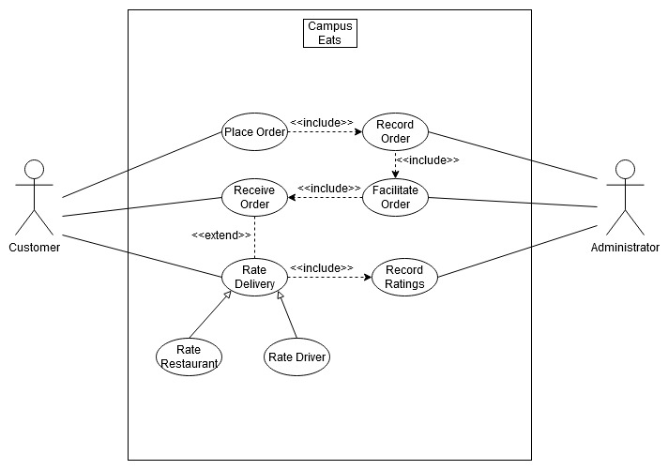
Use case diagram

Slide 6
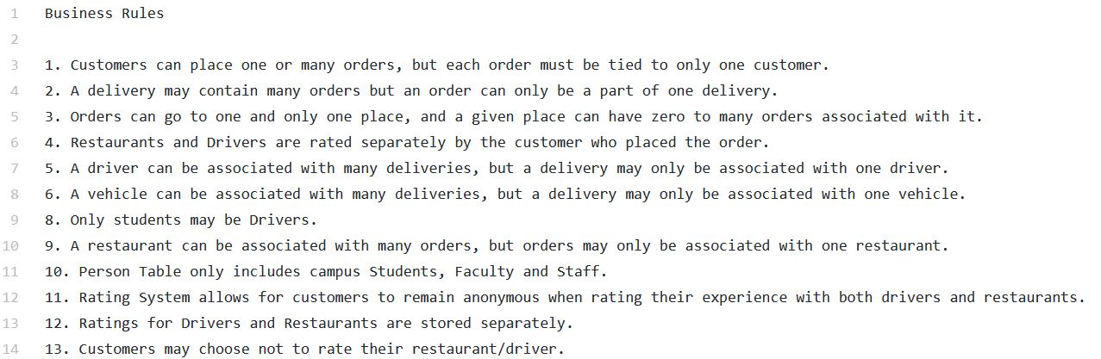
Business RUles

Slide 7

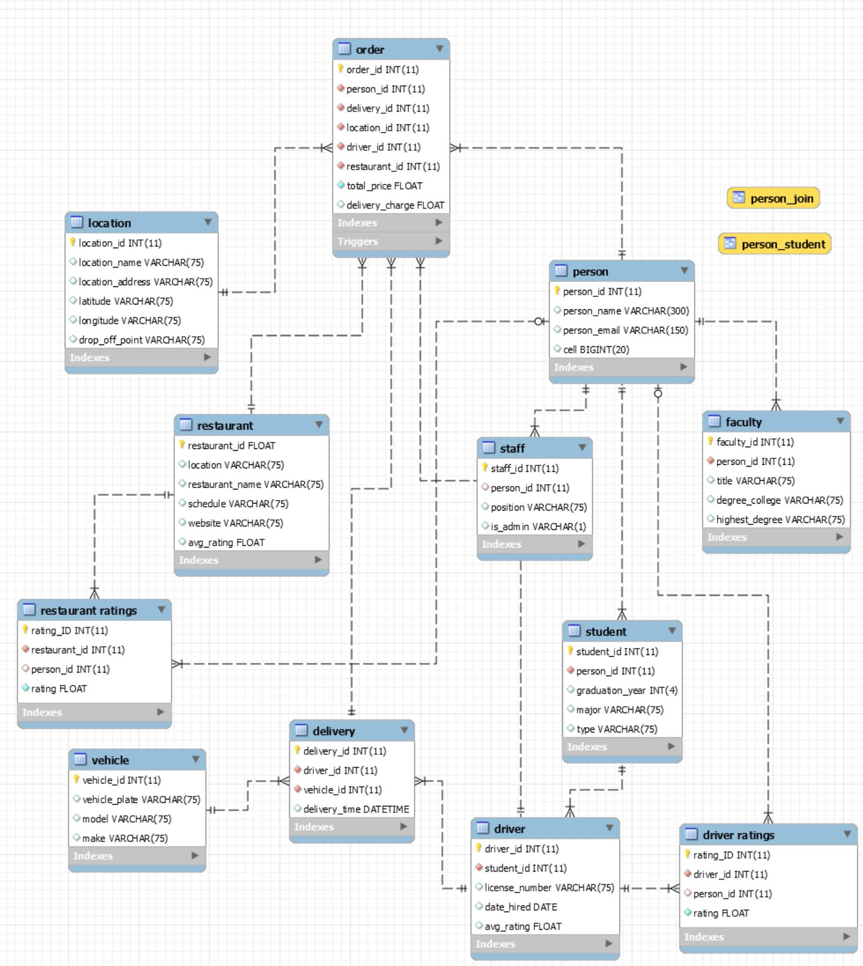

Enhanced Entity Relationship Diagram (EERD)

Slide 8
Github link
Click Me!

Slide 9
The End
Thanks for your time!

